Slide 1
Dairy Cattle Lameness:
Identification methods and challenges with imported foreign cattle in Russia
By: Adam Peffer
Infodairy.com

Slide 2
Overview
The “locomotion” method of identifying lame cows
Economics of lameness
Types of lameness issues
Current issues with foreign imported cattle

Slide 3
Which cow is lame ?

Slide 5
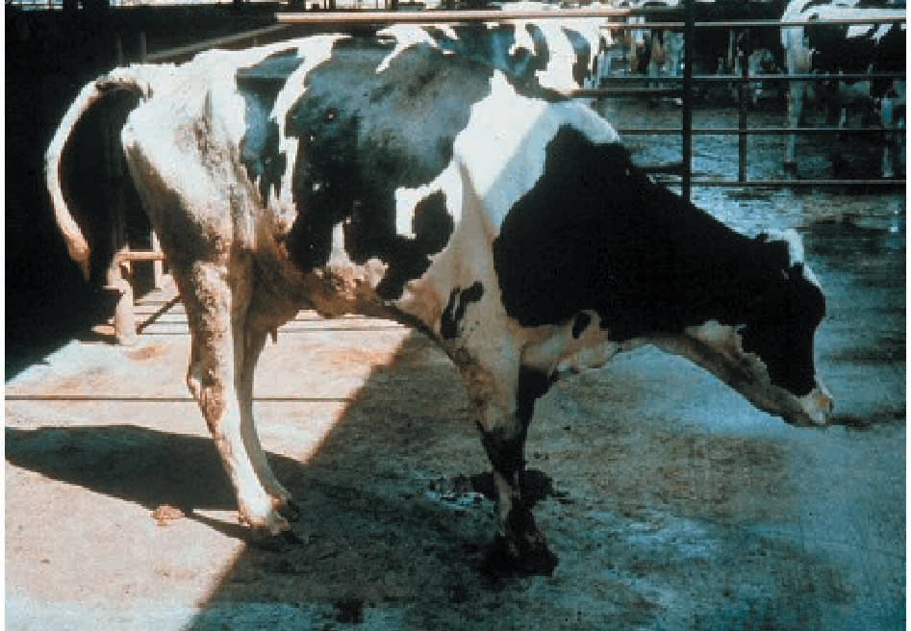

Slide 7
How do we define a lame cow?

Slide 8
* Adapted from Sprecher, D.J.; Hostetler, D.E.; Kaneene, J.B. 1997. Theriogenology 47:1178-1187 and contribution from Cook, N.B., University of Wisconsin.

Slide 10
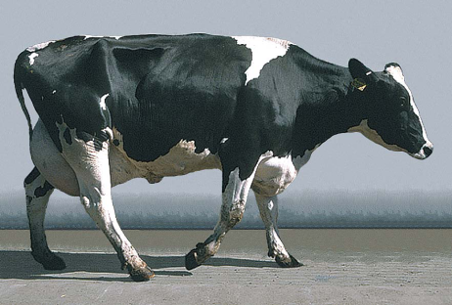
Locomotion score : 1
NORMAL
Description:
Stands and walks normally with a level back. Makes long confident strides.
Back Posture Standing: Flat
Back Posture Walking: Flat

Slide 11
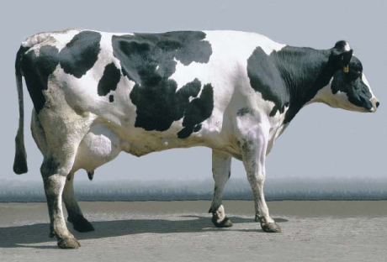
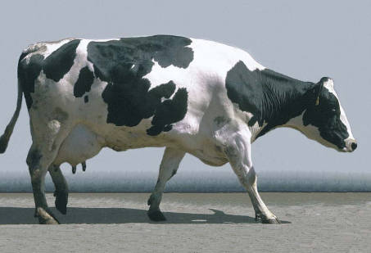
Locomotion score : 2
Mildly lame
Description:
Stands with flat back, but arches when walks. Gait is slightly abnormal.
Back Posture Standing: Flat
Back Posture Walking: Arched

Slide 12
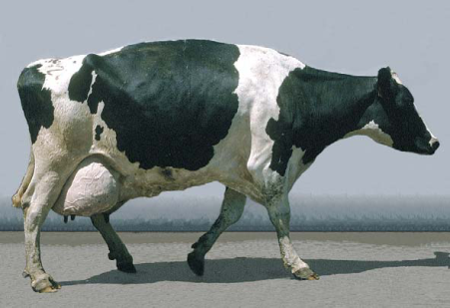
Locomotion score : 3
MODERATELY LAME
Description:
Stands and walks with an arched back and short strides with one or more legs. Slight sinking of dew-claws in limb opposite to the affected limb may be evident
Back Posture Standing: Arched
Back Posture Walking: Arched

Slide 13
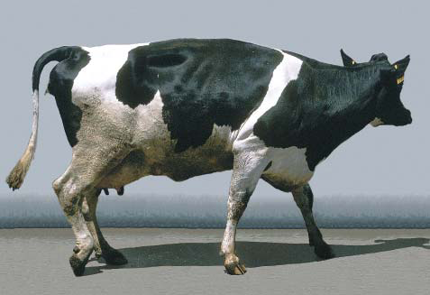
Locomotion score : 4
LAME
Description:
Arched back standing and walking. Favoring one or more limbs but can still bear some weight on them. Sinking of the dew-claws is evident in the limb opposite to the affected limb.
Back Posture Standing: Arched
Back Posture Walking: Arched

Slide 14
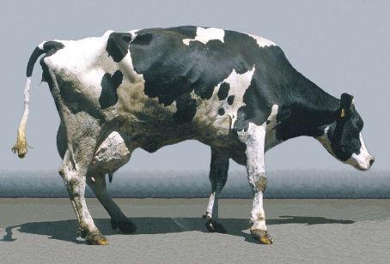
Locomotion score : 5
SEVERLY LAME
Description:
Pronounced arching of back. Reluctant to move, with almost complete weight transfer off the affected limb.
Back Posture Standing: Arched
Back Posture Walking: Arched

Slide 16
Does lameness have an impact on $$$$$ ????????????????

Slide 17
Costs Associated With Lameness
Researchers in the United States and Europe report the average
cost of lameness at over $346 per case. a
Costs associated with lameness include:
• Reduced milk yield b; compared to a Locomotion Score 1,
cows scoring a:
- 2 have 1% milk loss
- 3 have 3% milk loss
- 4 have 7% milk loss
- 5 have 16% milk loss
• Reduced fertility c; cows scoring a 3, 4 or 5 are:
• 2.8 times more likely to have increased days to first
service
- 15.6 times more likely to have increased days open
• 9.0 times more likely to have increased services /
conception
• Increased replacement costs c; cows scoring a 3, 4 or 5 are:
- 8.4 times more likely to be culled
• Increased labor and medication costs to treat lame cows. a
a Guard, Cornell University
b Juarez et al., 2003. Appl. Anim. Behaviour Sci. 83:1
c Sprecher et al., 1997. Theriogenology 47:1179

Slide 18
Estimated reductions in DM intake and milk yield related to LS
 | DM Intake | Milk Yield
LS | % reduction vs. LS of 1
2 | - 2 % | - 1 %
3 | - 5 % | - 3 %
4 | - 17 % | - 7 %
5 | - 36 % | - 16 %

Slide 21
“A dairy farmer who doesn’t have problems on his farm, doesn’t have cows”
Challenges are a fact of operating a dairy.
We need to learn how to recognize them, address them and minimize / eradicate them.
Locomotion scoring allows us to:
Understand the current situation
Monitor progress
Compare apples to apples

Slide 22
Categories of Lameness
Trimming
Nutrition
Environment

Slide 26
Current challenges with foreign imported cattle in Russia

Slide 27
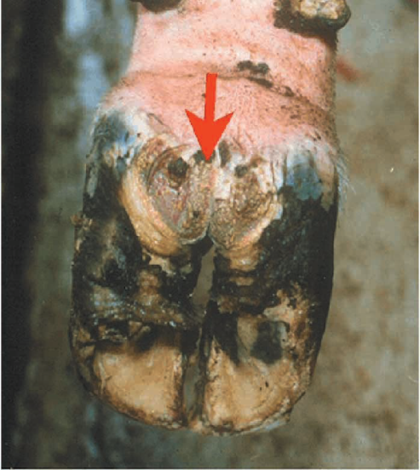
Hairy Heel Warts (papillomatous digital dermatitis)

Slide 28
History
Digital dermatitis (DD), a digital skin disease of cattle, was first described in 1974 in Italy and is characterized by inflammation of the skin, most times in the region of the bulb of the heel and coronet of the claw (Cheli and Mortellaro, 1974). Today, the disease has spread all over the world and has been reported at an endemic stage in the United Kingdom, The Netherlands, and most other countries in western Europe and the United States. (Brizzi, 1993; van Amstel et al., 1995; Clarkson et al., 1996; Rodrigues-Lainz et al., 1996, 1999; Read and Walker, 1998a; Wells et al., 1999; Murray et al., 2002; Somers et al., 2003). In other countries, such as Japan, Australia, and New Zealand, DD is treated as an incidental lesion (Kimura et al., 1993; McLennan and McKenzie, 1996; Vermunt and Hill, 2004). However, in Norway, DD is being considered increasingly problematic because of the switching from current tie-stall housing systems to free stalls (Sogstad et al., 2005). This is in accordance with the results of a recent Dutch study, where a clear influence of housing system on DD prevalence was found (Somers et al., 2003).

Slide 29
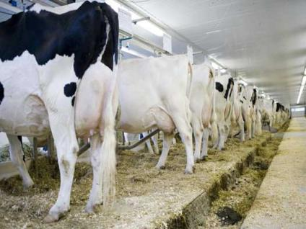
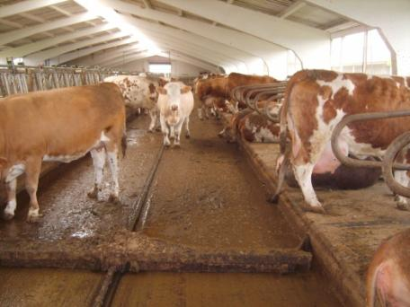
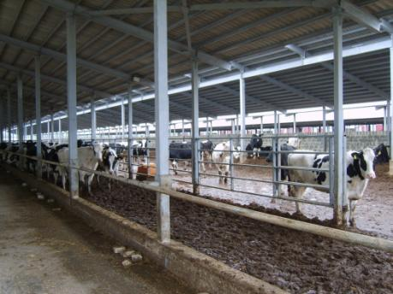

Slide 30
Scientific Names
Papillomatous Digital Dermatitis
Interdigital / Digital Papillomatosis
Common Names
Footwarts, Heel Warts, Hairy Footwarts
Strawberry Foot Disease
Causes
Cause is still unknown
Footwarts have invasive spirochetes that are responsive to antibiotics
Environments may predispose (poorly drained lots, freestalls, abrasive soil/concrete)

Slide 31
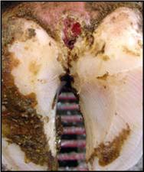
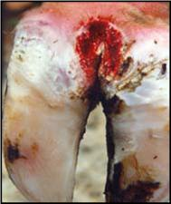
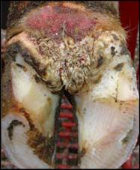

Slide 32
Disease Characteristics
First calf heifers most often affected
Primarily hind feet
Severe lameness, walking on toes, loss of body weight, and decreased milk yield and fertility
Little or no digital swelling (in contrast to "Foot rot")
Lesion Characteristics
Usually at back of foot near interdigital cleft and heel
Sometimes at front of foot, in the interdigital cleft or near dewclaws
Early lesion: sharply demarcated, flat, dime-sized, round to oval, moist, tufted, strawberry-like surface
Mature lesion: larger (up to 2" across), usually raised; sometimes with long brown/black tufts or hair-like, tissue projections on surface
Long hairs at edge of lesion
Very painful
May persist for many months or may regress in dry weather

Slide 33
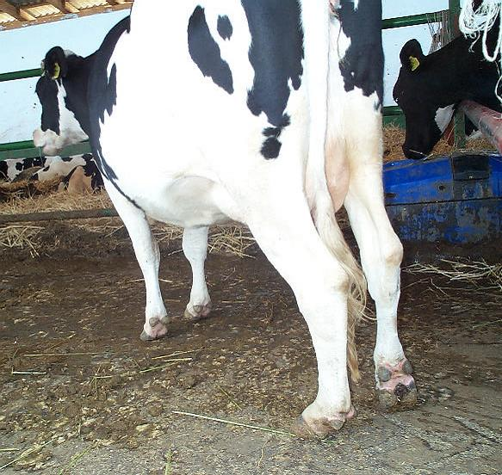

Slide 34
Treatment and Control
Cleansing, debridement plus topical application of antibiotics under a wrap are usually highly effective
Treatment program should also include non-lame affected animals
Recurrent or new lesions may develop within 7-12 weeks
Wart vaccines are currently ineffective
Repetitive use of chemical or antibiotic foot bath/spray may be effective
Manage free stalls so as to keep feet clean & dry
Know source of addition and purchase clean animals
Quarantine, examine and treat new arrivals, especially heifers
Treatment Protocol
Topical Application (spray)
Terramycin or Tetracycline
1 packet of terramycin 343 - Pfizer (102.4 grams) in 1 gallon of distilled water
Use as a topical spray at the rate of 10 to 20 cc per foot. Apply to heels and between toes plus on visible lesions.
Week 1: Treat all feet of all cows once daily for 5-7 consecutive days.
Week 2 and Beyond: Continue daily topical treatment of all cows with visible lesions only.
Recommend: Repeated in 6-8 weeks in herds with recurrent infections
Footbath Preparation
Tetracycline, 0.1%
4 grams of Tetracycline in 25 gallons of water
Place footbath in return alley, not in parlor. Wash dirt and manure off of the cow's feet prior to walking through the footbath. Change the footbath after 200-300 cows have passed through it. Prolonged use without change may increase the risk of foot lesions.
Caution: when using antibiotics in footbaths, there is an increased risk to lactating cows that they will ingest the solution and cause possible antibiotic residue in milk
Recommend twice weekly.

Slide 35
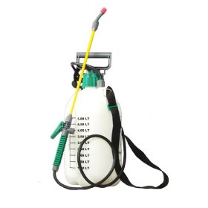
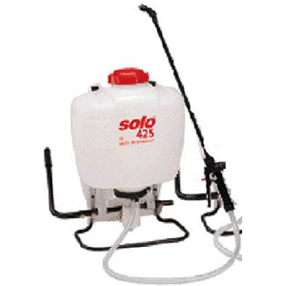

Slide 37
Dermatitis
Caused by bacteria
Lives in environment (manure)
Painful to cow
Easily managed and treated
A clean dry environment minimizes exposure
Proper uses of footbaths necessary

Slide 38
In Review
What is a lame cow
The “locomotion” method of identifying lame cows
Economics of lameness
Types of lameness issues
Current issues with foreign imported cattle

Slide 39
March 1st, 2009 www.infodairy.com

